Slide 1
Marketing Specialists in The Motor Industry
Dealer Template Websites

Slide 2
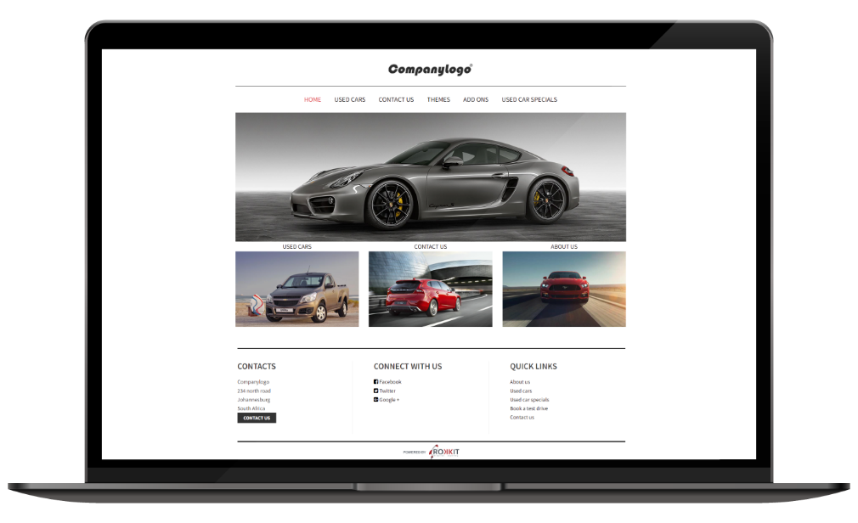
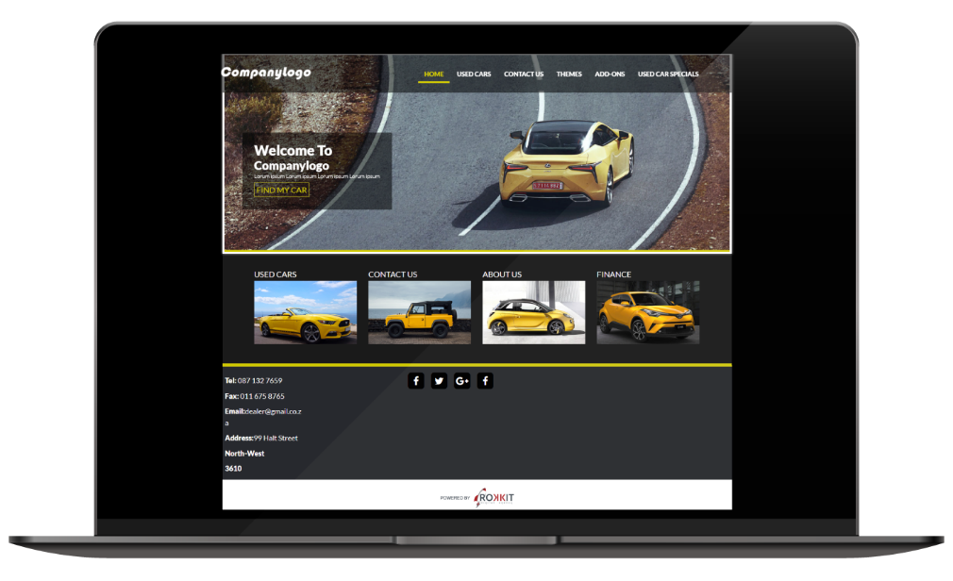
Dealer Template Websites
Unlocking Digital Success, One Click at a Time!
Here at Rokkit we have three exciting themes for you to choose form from classic to sporty there is something for everyone!
Modern Theme
Sporty Theme
Template Websites
https://dlrace.co.za/
https://carsonridge.co.za/
https://intercars.co.za/
R600 + R250 for a used car feed P/M
Hosting and Maintenance
Monthly
Excl. VAT

Slide 3
Dealer Template Websites
Unlocking Digital Success, One Click at a Time!
Using Rokkit Digital Agency for building dealership websites can offer several benefits and advantages. We have the necessary skills, experience, and expertise.
Daily Stock Feed - Making sure your vehicles are found online is our priority!
Save Time - Less admin work for the dealer allows for a focus on selling more cars!
Hosting and Security Maintenance – Weekly security and maintenance checks are done.
Credibility – A website is a way of showing legitimacy and gives customers assurance in doing business with you.
3 Page Website
5 Page Website
7 Page Website
From
From
From
7425
9075
5775
R
R
R
Once Off
Once Off
Once Off
Excl. VAT
Excl. VAT
Excl. VAT
Maximum Pages: 3
• Pages – Home, Used Car Feed,
Contact Us
• Includes 2 tiles on home page
• Maximum Pages: 5
• Pages – Home, Used Car Feed,
Contact Us & 2 Add-Ons
• Includes 3 tiles on home page
• Maximum Pages: 7
• Pages – Home, Used Car Feed,
Contact Us & 4 Add-Ons
• Includes 4 Tiles on Home Page
R600 + R250 for a used car feed P/M
Hosting and Maintenance
Excl. VAT

